Slide 1
DEVISING CONVERSION OF MgCl₂ TO MgCO₃

Slide 2
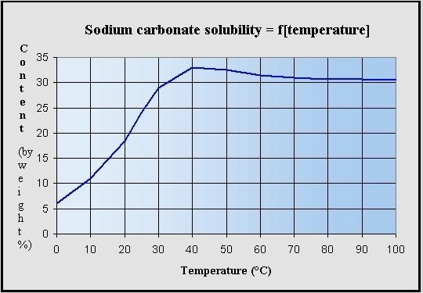

Slide 3
MgCl2
MgCl2
MIXER
REACTOR
MgCO3+NaCl
SEPARATOR
NaCl
Na2CO3+water
+Na2CO3+MgCl2
MgCO3
Na2CO3

Slide 4
CONVERSION = 70%
Na2CO3(A) + MgCl2(B) -> MgCO3(C) + 2NaCl(D)
106 95 84 58.5*2
AMOUNT OF A AND B REQUIRED TO PRODUCE 4 TON OF C
IDEALLY, A = 5.048 TON
B = 4.524 TON

